Slide 1
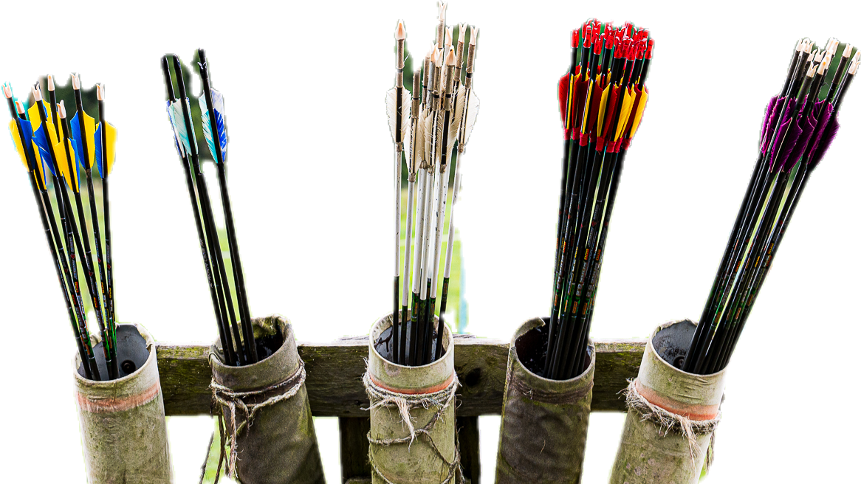



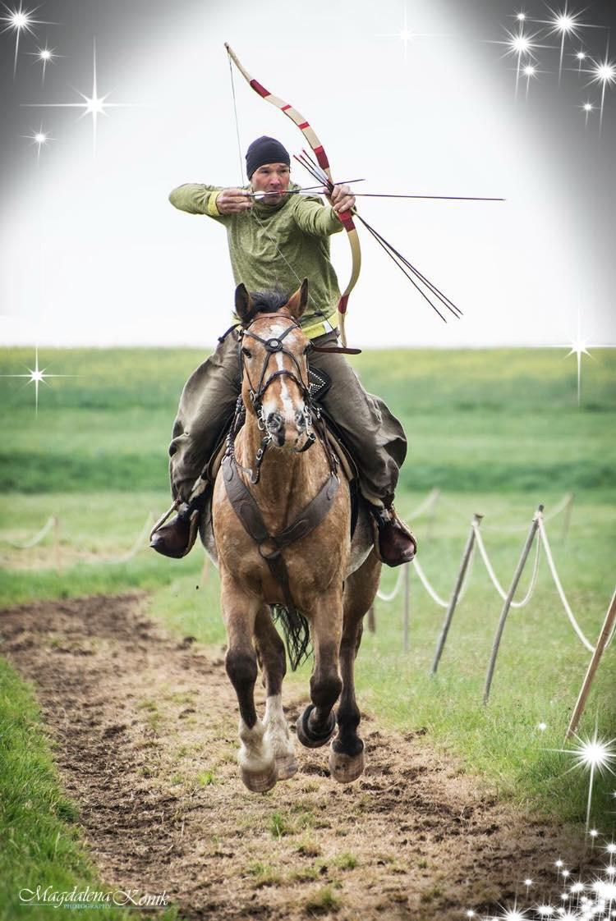
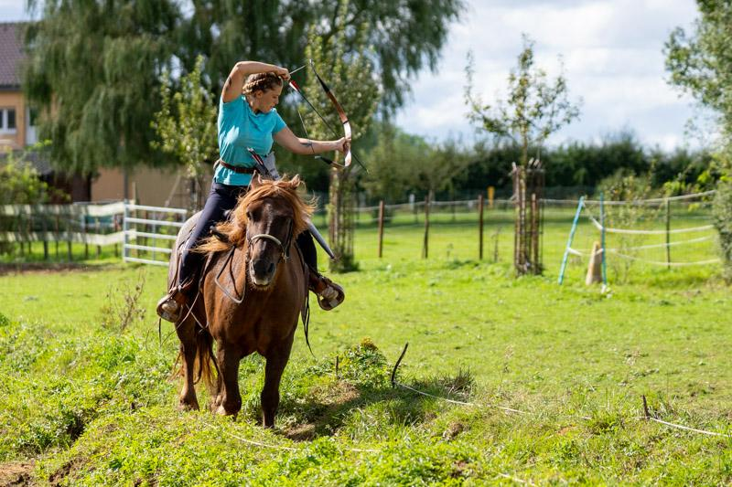
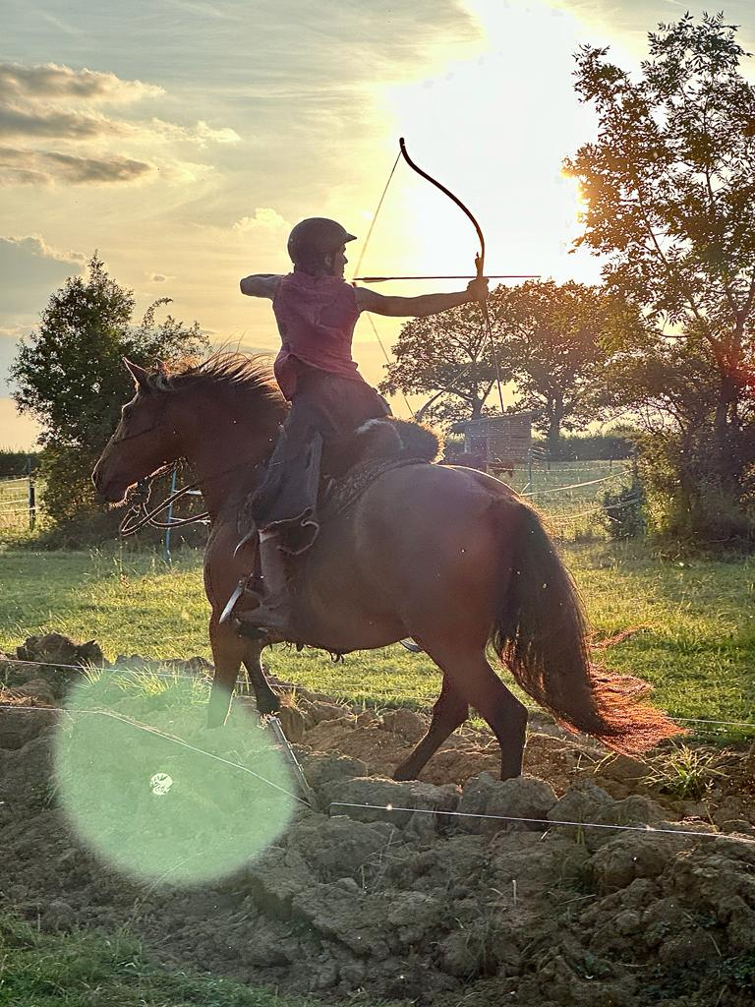
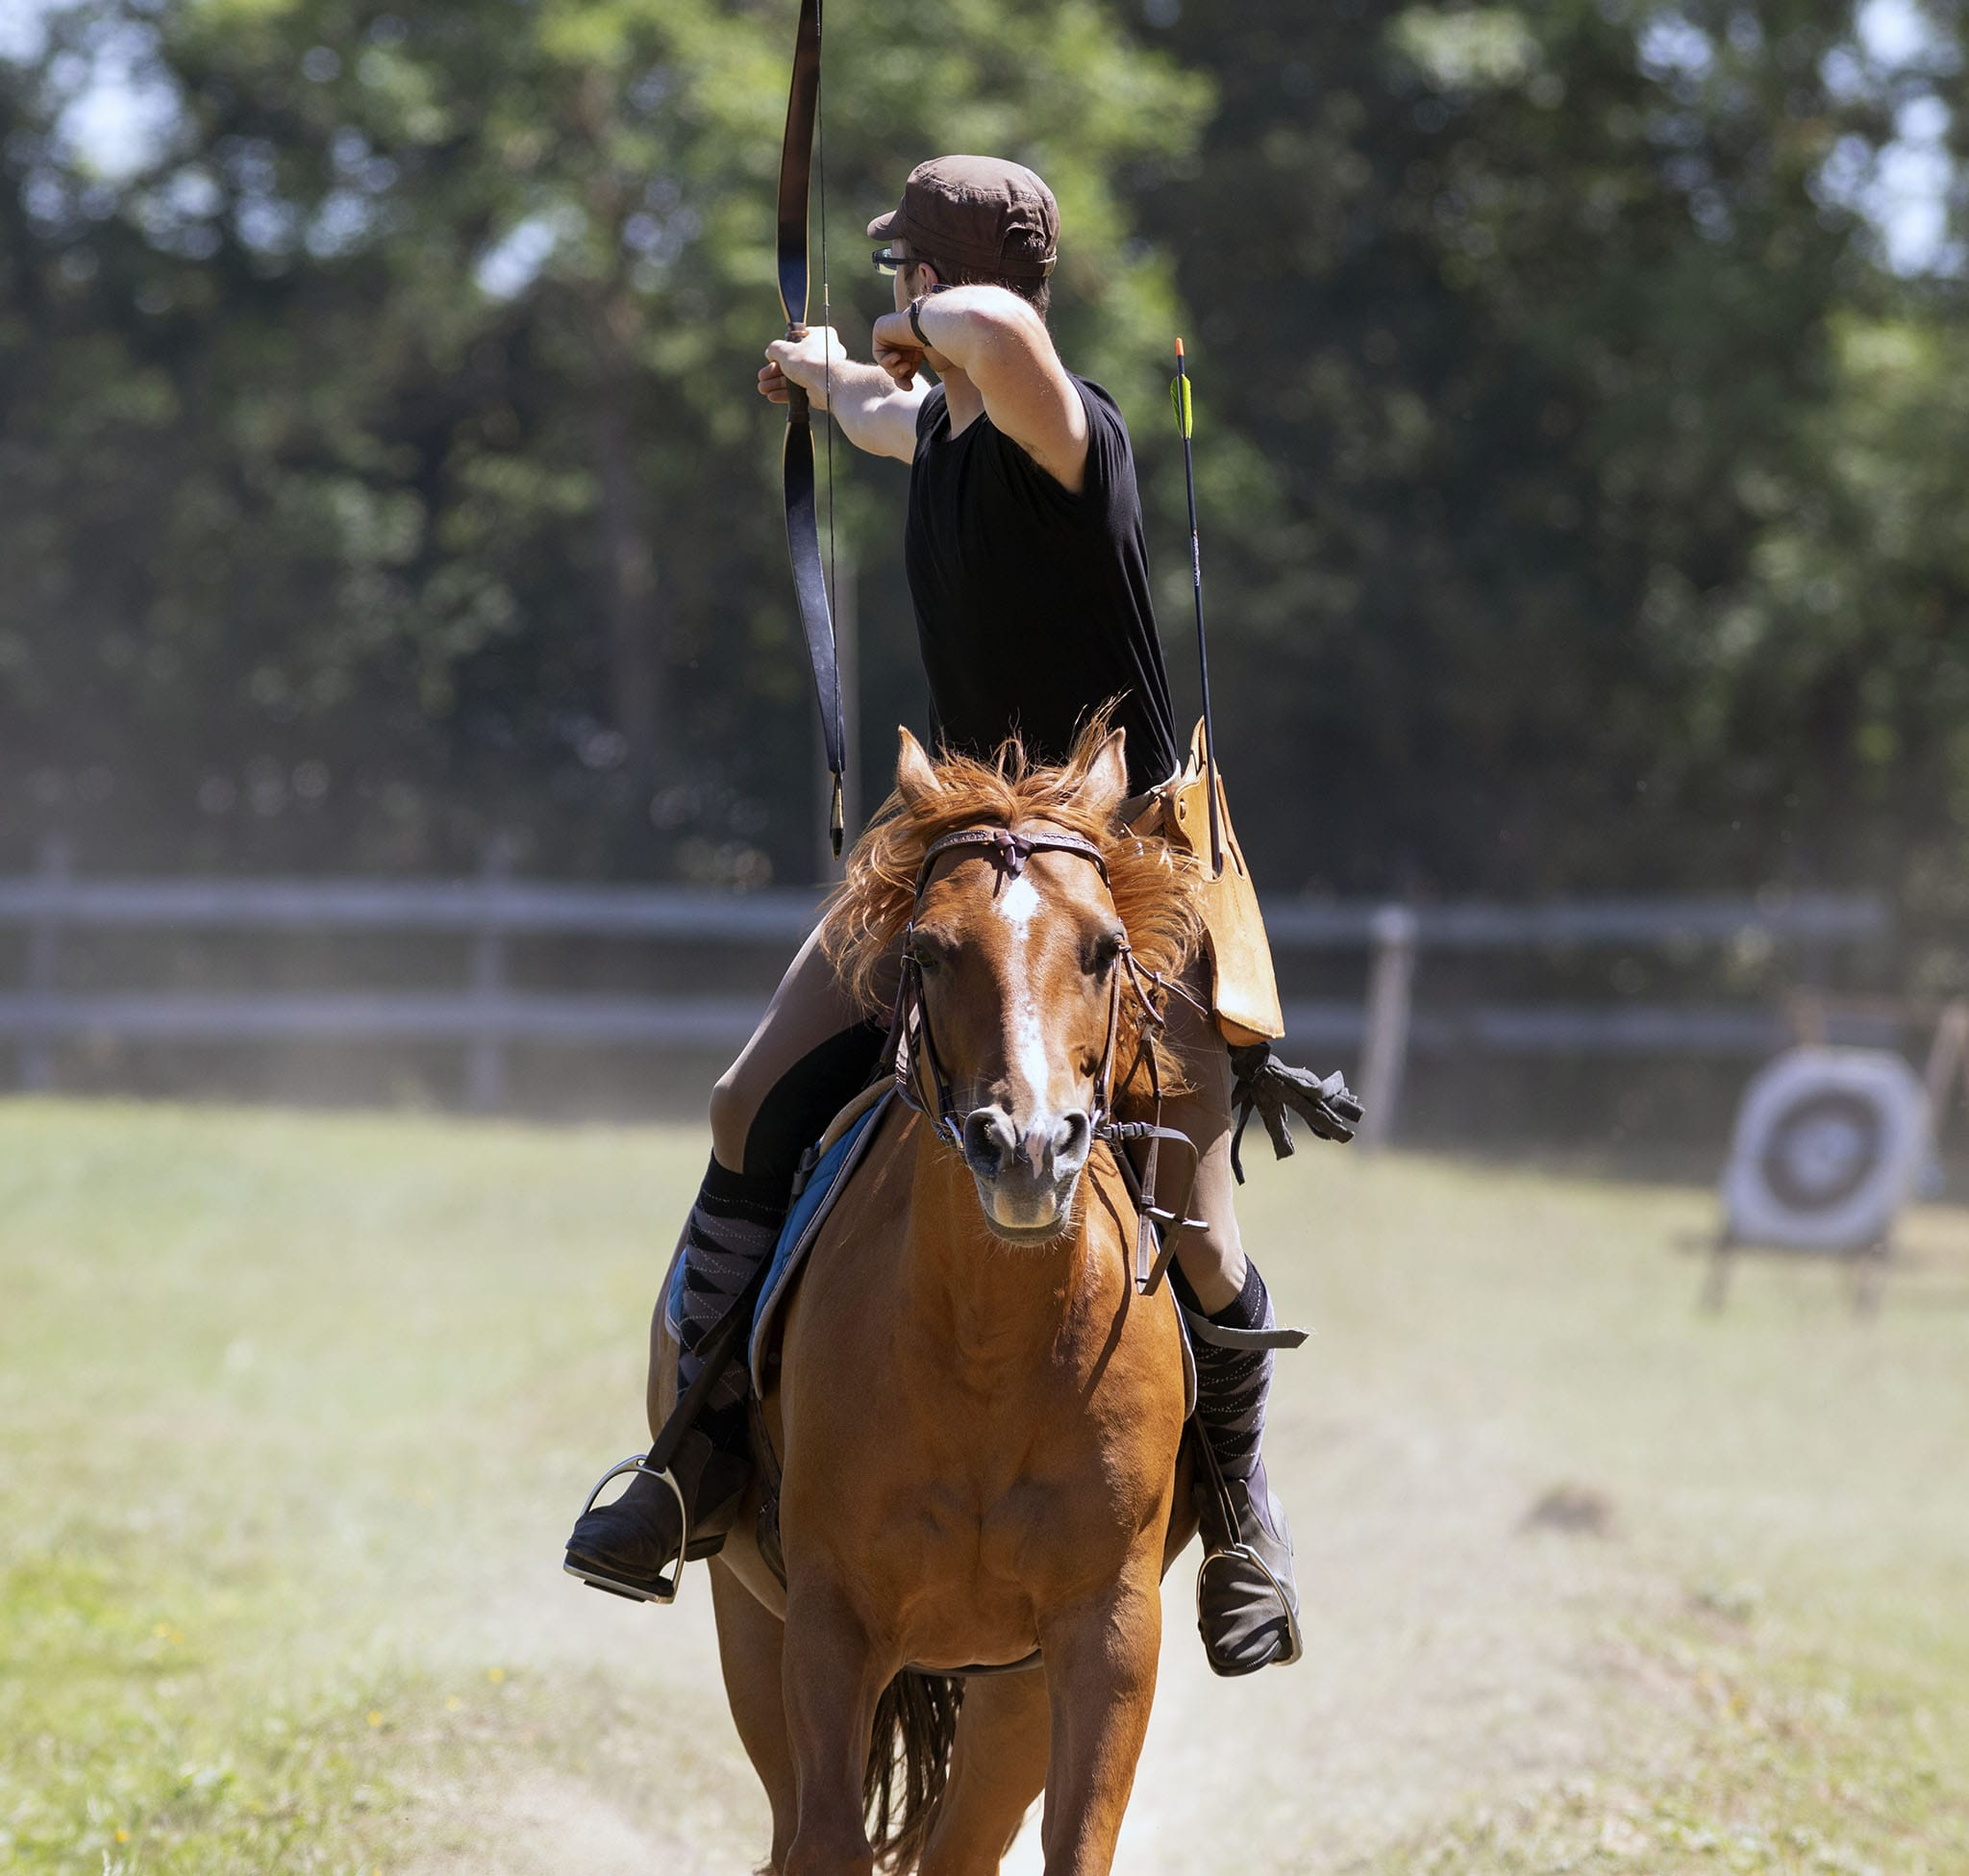
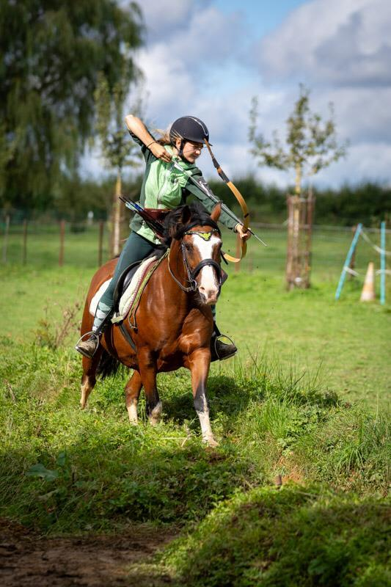
Limpach Open 2025
Fir Iessen a Gedrenks suergen d‘Fliiteschesser an d‘Ginbar
Klenge Moart
1 & 2 August Kassai Competition
3. August IHAA Competition
3. August Children & Beginner Competition & Open Door
In 98, rue de Soleuvre L-4499 Limpach

